Slide 1

Data Wrangling Project
Study IMDb top 250 and popular 100 movies.

Slide 2
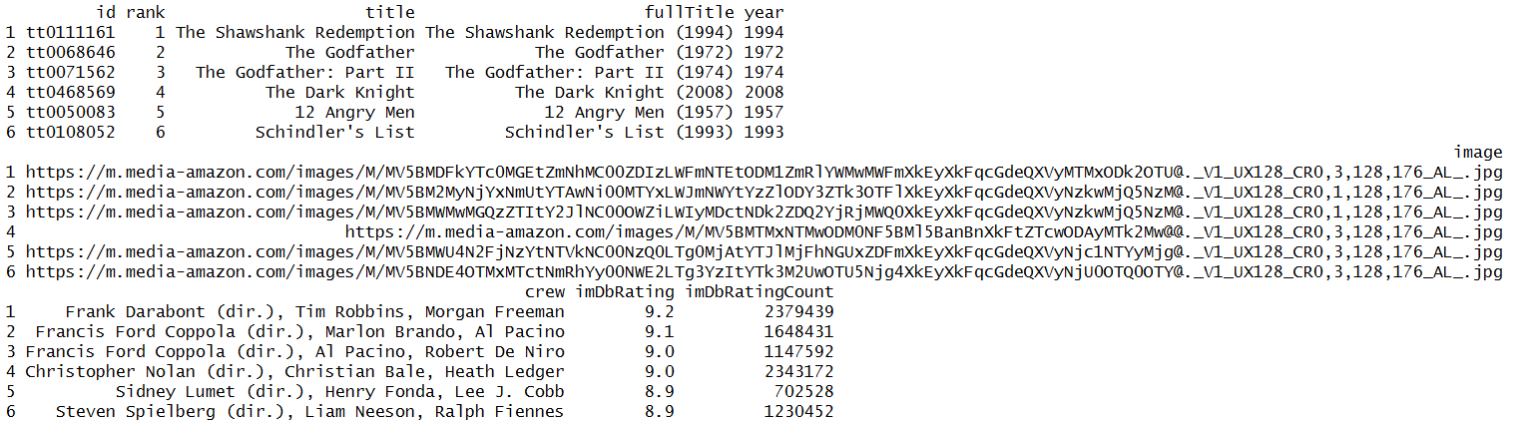
Source
IMDb API weibsite:
Apply for an API key, grasp two list of data: top 250 movies & popular movies (100).

Slide 3
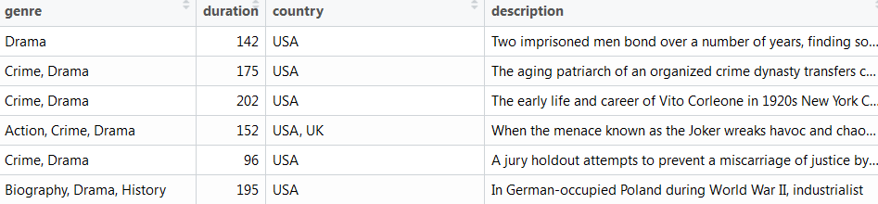
Source
Kaggle:
https://www.kaggle.com/stefanoleone992/imdb-extensive-dataset?select=IMDb+ratings.csv
Select the following some useful columns from the attached link.
Top 250: no Zack Snyder’s Justice League (2021), no Soul (2020).
Popular 100: one half missing.

Slide 4
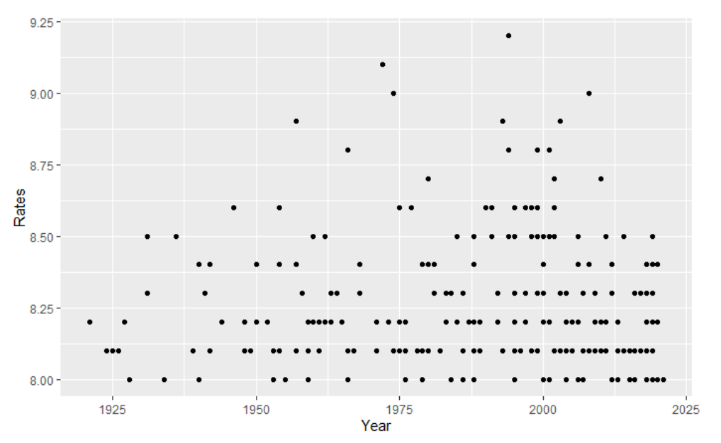
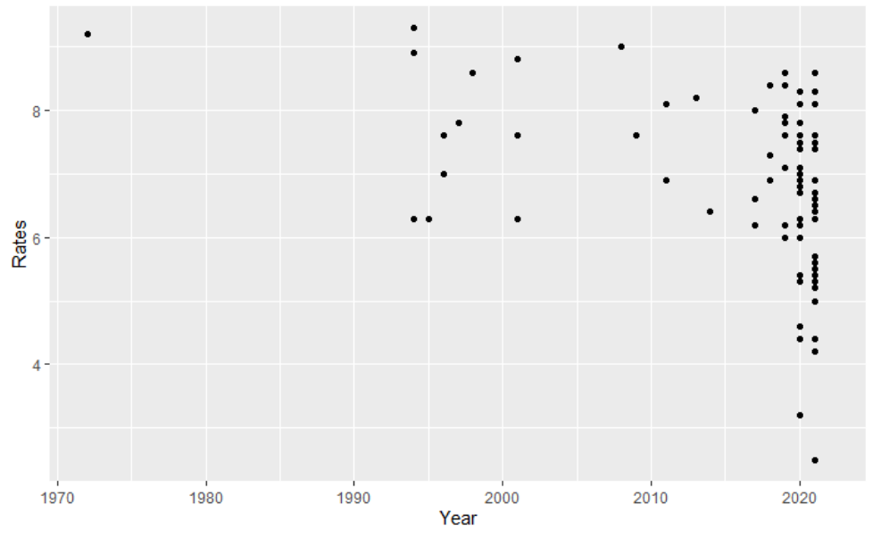
Data visualization
Ratings versus Year in top 250 movies
Ratings versus Year in popular movies

Slide 5
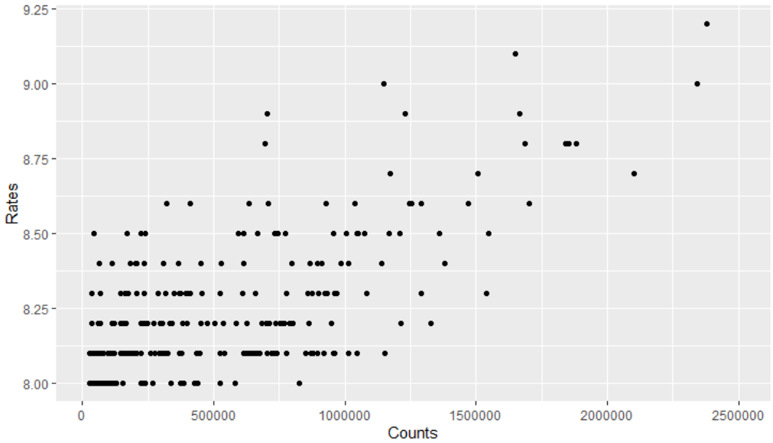
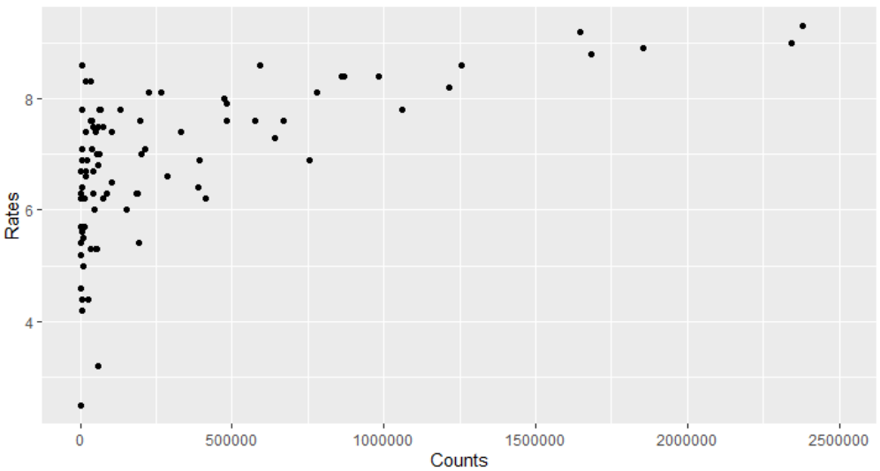
Data visualization
Ratings versus Counts in top 250 movies
The Shawshank Redemption (1994)
Ratings versus Counts in popular movies
The Godfather (1972)

Slide 6
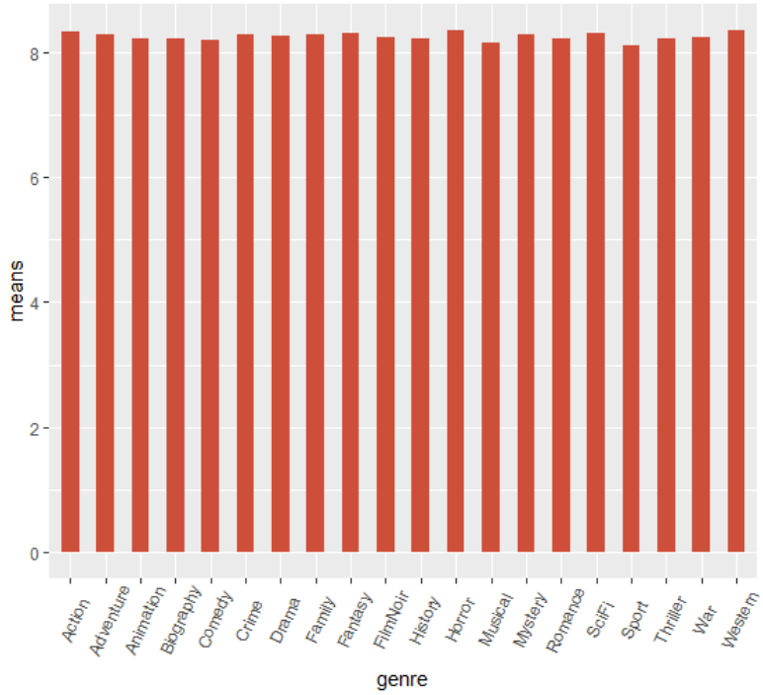
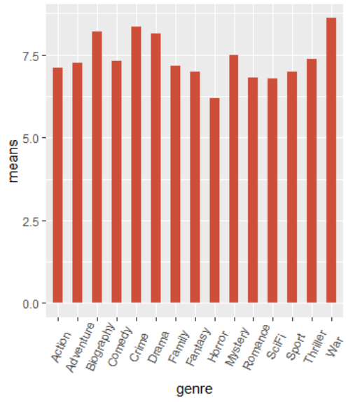
Data visualization
Mean ratings for top 250 movies in genres
Mean ratings for popular movies in genres

Slide 7
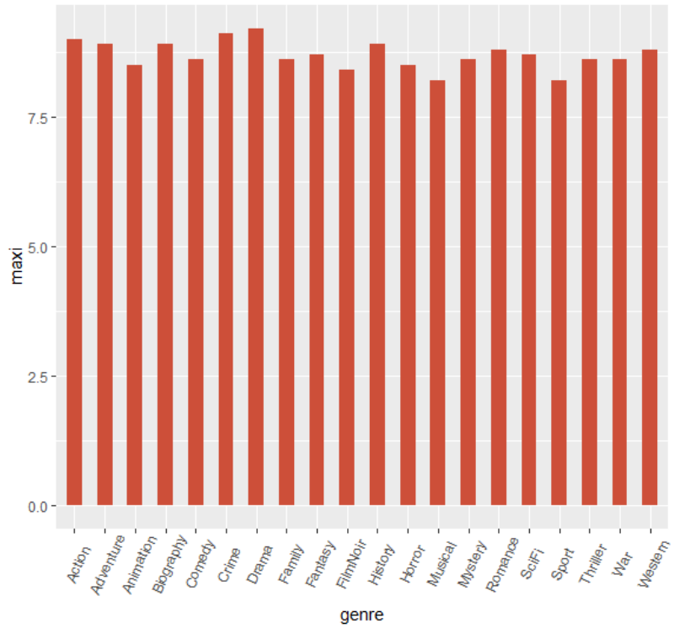
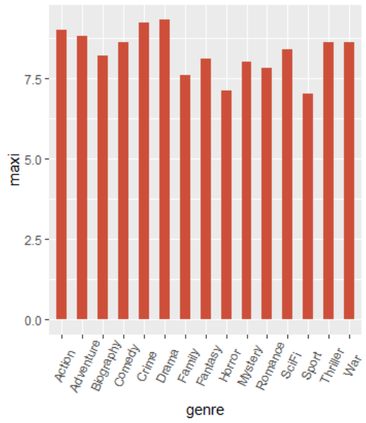
Data visualization
Maximum ratings for top 250 movies in genres
Maximum ratings for popular movies in genres

Slide 8
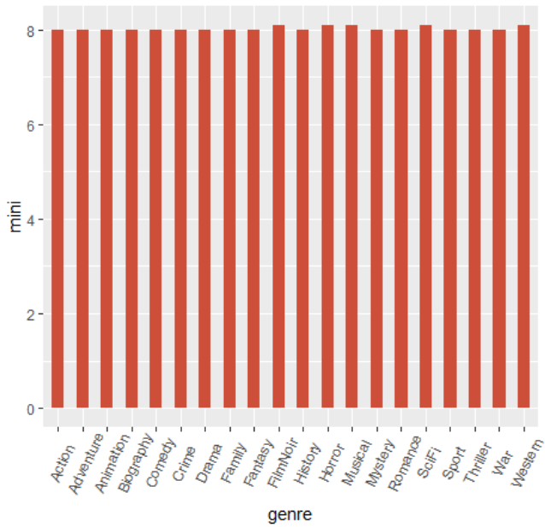
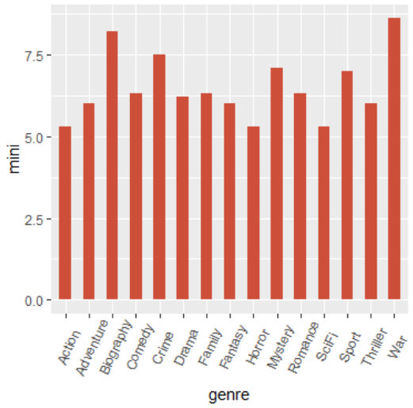
Data visualization
Minimum ratings for top 250 movies in genres
Minimum ratings for popular movies in genres

Slide 9
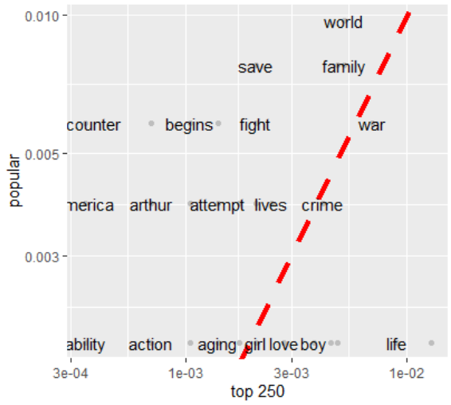
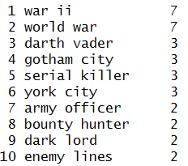
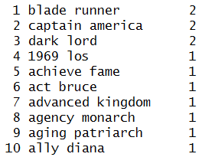
Data visualization
10 most common bigrams in top 250
10 most common bigrams in popular
The correlation between these two lists is 0.34

Slide 10
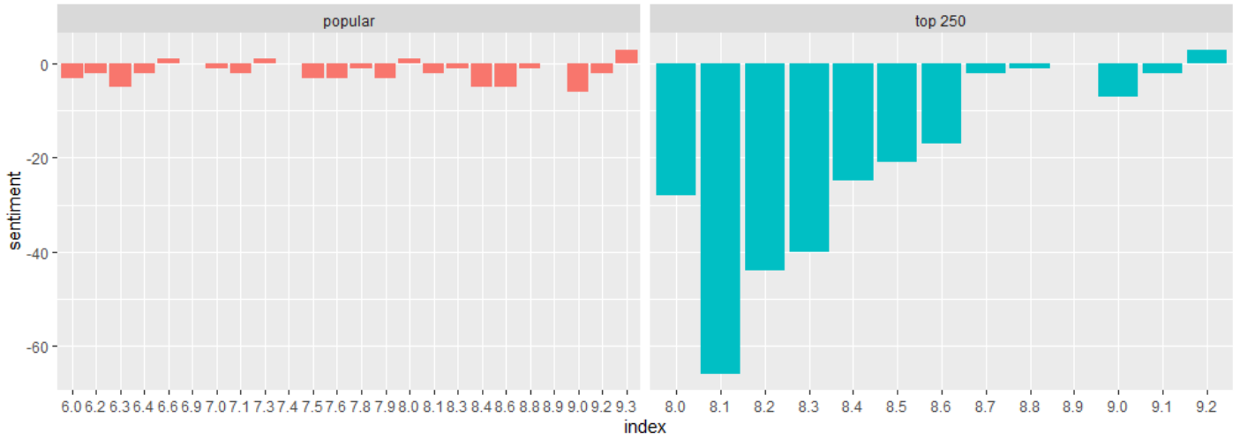
Data visualization
In the list of the top 250 movies, it is surprised to see that a trend of decreasing in negative information as the scores rising.

Slide 11
Discussion
Among the current mainstream genres, high-scoring movies can be produced under any genre.
Perhaps war movies, due to their high production costs, generally get a not-low rating.
In the descriptions of these movies, more negative words appear. Does it reflect that the current movies convey too much negative information? Or maybe negative adjectives are more attractive to the audience.
Do these movies make people feel positive or negative? Maybe in the future it is worthwhile to collect these movie-related reviews to study this point.

Slide 12
T
H
A
N
K
S

